Slide 1




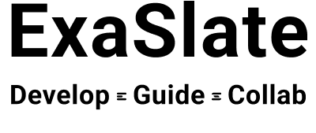
Applied Computational Fluid Dynamics with OpenFOAM
Day -1

Slide 2
Contents
Introduction
CFD fundamentals
Mathematical operations
Governing Differential Equations
Taylor series + FDM
Exercise – 1 (Installations)
Exercise – 2 (First order forward difference method)
Kumaresh Selvakumar kumaresh@exaslate.com

Slide 3
Introduction – About this course
Course duration per session: 2 hrs
Total course duration: 30 – 35 hrs
Requirements:
Virtual box and installing OS & softwares.
Interest to learn CFD using OpenFOAM & Octave
Interest to ask questions in discussion forum (GitHub)
Exercises (equal weightages)
Kumaresh Selvakumar kumaresh@exaslate.com

Slide 4
Introduction – References
Ferziger and Peric; Computational Methods for Fluid Dynamics.
S. Patankar; Numerical Heat Transfer and Fluid Flow.
Tannehill et al.; Computational Fluid Mechanics and Heat Transfer.
Versteeg, Malalasekera; An Introduction to Computational Fluid Dynamics.
C.J. Greenshields, H.G. Weller; Notes on CFD: General Principles (OpenFOAM)
Kumaresh Selvakumar kumaresh@exaslate.com

Slide 5
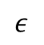
CFD fundamentals – Fluid
A substance whose molecular structure offers no resistance to external forces - Ferziger, Peric
Fluid parcel
Fluid molecules
Kumaresh Selvakumar kumaresh@exaslate.com

Slide 6
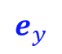
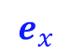
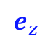
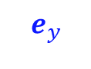
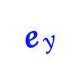
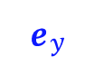
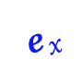
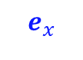
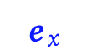
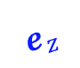
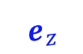
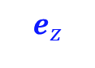
CFD fundamentals – Fluid
A substance whose molecular structure offers no resistance to external forces - Ferziger, Peric
Fluid parcel
Rotation
Expansion
Deformation
Kumaresh Selvakumar kumaresh@exaslate.com

Slide 7
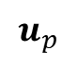
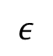
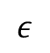

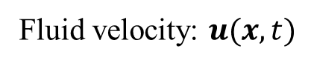
CFD fundamentals – Fluid
A substance whose molecular structure offers no resistance to external forces - Ferziger, Peric
Molecular
physics
Fluid parcel
Continuum
Fluid molecules
Kumaresh Selvakumar kumaresh@exaslate.com

Slide 8
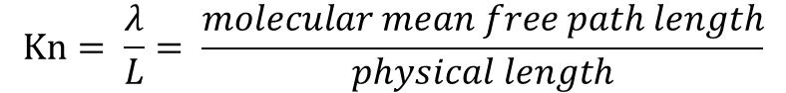
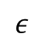
https://en.wikipedia.org/wiki/Knudsen_number#References
CFD fundamentals – Continuum
Knudsen number:
Kn < 0.01 | Continuum flow
0.01 < Kn < 0.1 | Slip flow
0.1 < Kn < 10 | Transitional flow
Kn > 10 | Free molecular flow
In physics, mean free path is the average distance over which a moving particle
Kumaresh Selvakumar kumaresh@exaslate.com

Slide 9
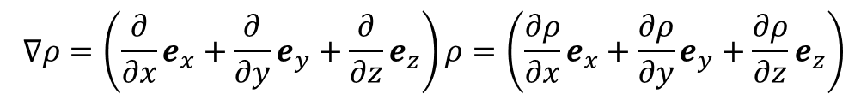

Mathematical operations
e_{y}
Gradient:
e_{x}
e_{z}
Source: https://www.youtube.com/watch?v=vWFjqgb-ylQ
https://www.youtube.com/watch?v=fZ231k3zsAA
Kumaresh Selvakumar kumaresh@exaslate.com

Slide 10
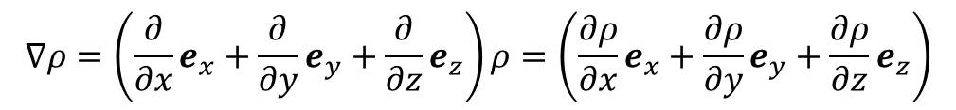
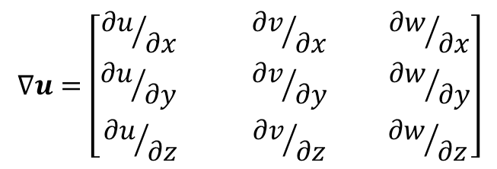
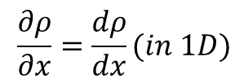
Mathematical operations
Gradient:
e_{y}
e_{x}
e_{z}
Kumaresh Selvakumar kumaresh@exaslate.com

Slide 11
Mathematical operations
Divergence:
In vector calculus, divergence is a vector operator that operates on a vector field, producing a scalar field giving the quantity of the vector field's source at each point.
More technically, the divergence represents the volume density of the outward flux of a vector field from an infinitesimal volume around a given point.
As an example, consider air as it is heated or cooled. The velocity of the air at each point defines a vector field. While air is heated in a region, it expands in all directions, and thus the velocity field points outward from that region. The divergence of the velocity field in that region would thus have a positive value. While the air is cooled and thus contracting, the divergence of the velocity has a negative value.
Kumaresh Selvakumar kumaresh@exaslate.com

Slide 12
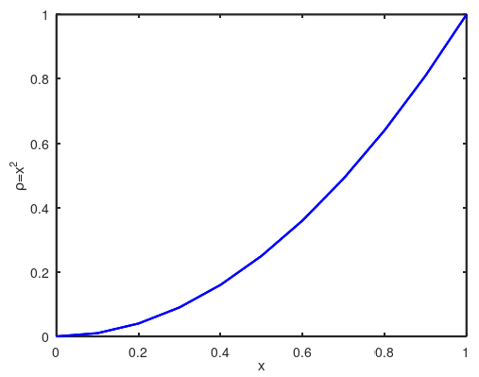
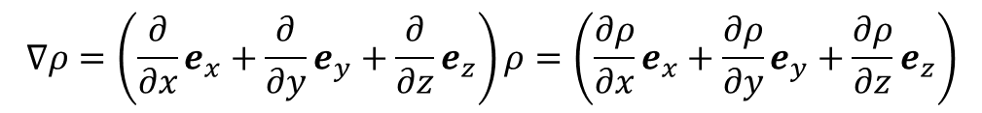
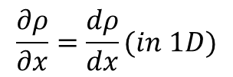
Mathematical operations
Gradient
e_{y}
e_{x}
e_{z}
Kumaresh Selvakumar kumaresh@exaslate.com

Slide 13
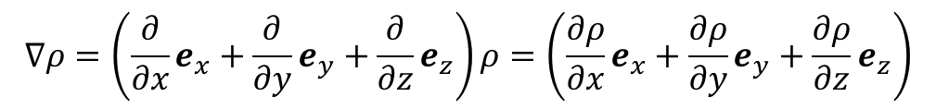
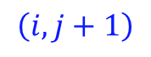
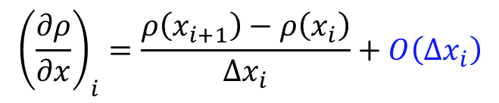
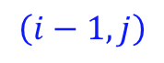
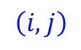
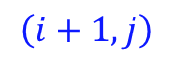
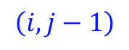
Finite Difference Method (FDM)
Kumaresh Selvakumar kumaresh@exaslate.com

Slide 14
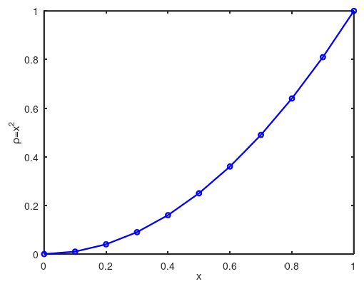
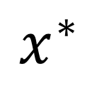
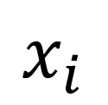
Taylor series expansion
$$x_{i}$$
$$x^{∗}$$
$$ρ\left(x^{∗}\right)=ρ\left(x_{i}\right)+\left(x^{∗}−x_{i}\right){\left(\frac{dρ}{dx}\right)}_{i}+{\left(x^{∗}−x_{i}\right)}^{2}{\left(\frac{d^{2}ρ}{dx^{2}}\right)}_{i}+{\left(x^{∗}−x_{i}\right)}^{3}{\left(\frac{d^{3}ρ}{dx^{3}}\right)}_{i}+…$$
Kumaresh Selvakumar kumaresh@exaslate.com
Notes:
https://www.youtube.com/watch?v=Z7sDYzJjMa4
T_n(x) = f(a) + (f’(a) /1!) (x-a) + (f^2(a)/2!) (x-a)^2 + ……
T_5(x) = f(0) + (f’(0) /1!) (x-0) + (f^2(0)/2!) (x)^2 + ……
f(x) = e^x; f(0) = 1
f'(x) = e^x; f’(0) = 1
f^2(x) = e^x; f^2(0) = 1
f^3(x) = e^x; f^3(0) = 1
f^4(x) = e^x; f^4(0) = 1
f^5(x) = e^x; f^5(0) = 1
f(x) = sinx; f(0) = 0
f'(x) = cosx; f’(0) = 1
f^2(x) = -sinx; f^2(0) = 0
f^3(x) = -cosx; f^3(0) = -1
f^4(x) = sinx; f^4(0) = 0
f^5(x) = cosx; f^5(0) = 1

Slide 15
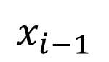
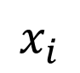
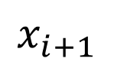
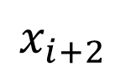
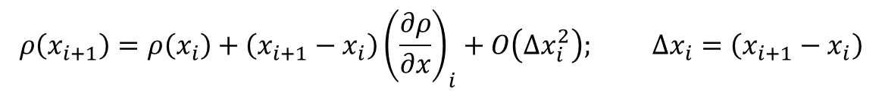
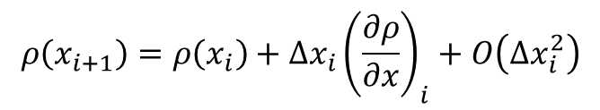
Taylor series expansion
Kumaresh Selvakumar kumaresh@exaslate.com

Slide 16
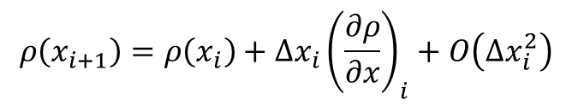
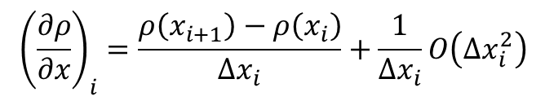
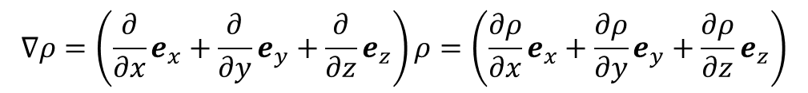
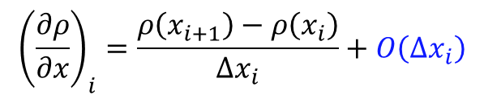
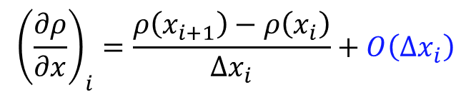
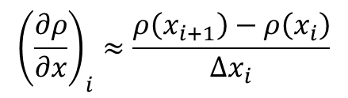
Taylor series and FDM
Taylor series:
Finite difference
First order forward difference scheme
Kumaresh Selvakumar kumaresh@exaslate.com

Slide 17
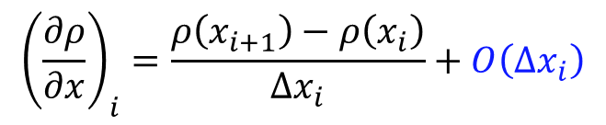





Analytical and Numerical solutions
Numerical result
Resolved in OCTAVE
Analytical result
Kumaresh Selvakumar kumaresh@exaslate.com

Slide 18

Exercise – 2
OCTAVE
Analytical and Numerical solutions
Analytical | Numerical
An analytical solution involves framing the problem in a well-understood form and calculating the exact solution. | A numerical solution means making guesses at the solution and testing whether the problem is solved well enough to stop.
Numerical result
Analytical result
Kumaresh Selvakumar kumaresh@exaslate.com
Notes:
'gca' sets the current axes for the current figure which is created before.
a = linspace(0,10,150);
Can everyone solve this problem for first order (forward) difference scheme
Can everyone solve this problem for x^ 2 and x^3

Slide 19






Taylor series: Summary
$$x_{i−1}$$
$$x_{i}$$
$$x_{i+1}$$
$$x_{i+2}$$
First order forward difference
Kumaresh Selvakumar kumaresh@exaslate.com

Slide 20

Exercise – 2
Kumaresh Selvakumar kumaresh@exaslate.com

Slide 21




Installations
Preconfiguration packages:
https://1drv.ms/f/s!AqT2YEB97-1RgP8MtsMPqoOGsq4ddg?e=IocXv0
List
Virtual Box [to create virtual machines]
Operating System: Ubuntu 24.04.1 [Install OpenFOAMv2412 & Octave]
AnyDesk [For remote access]
Create a github account:
https://github.com/exaslate-learn/applied-cfd-using-openfoam-ksr-spring-2025
Discussion forum:
https://github.com/exaslate-learn/applied-cfd-using-openfoam-ksr-spring-2025/discussions
Kumaresh Selvakumar kumaresh@exaslate.com

Slide 22


Exercise – 1 ➔ Install packages
Kumaresh Selvakumar kumaresh@exaslate.com

Slide 23
YOU
THANK

